Slide 1


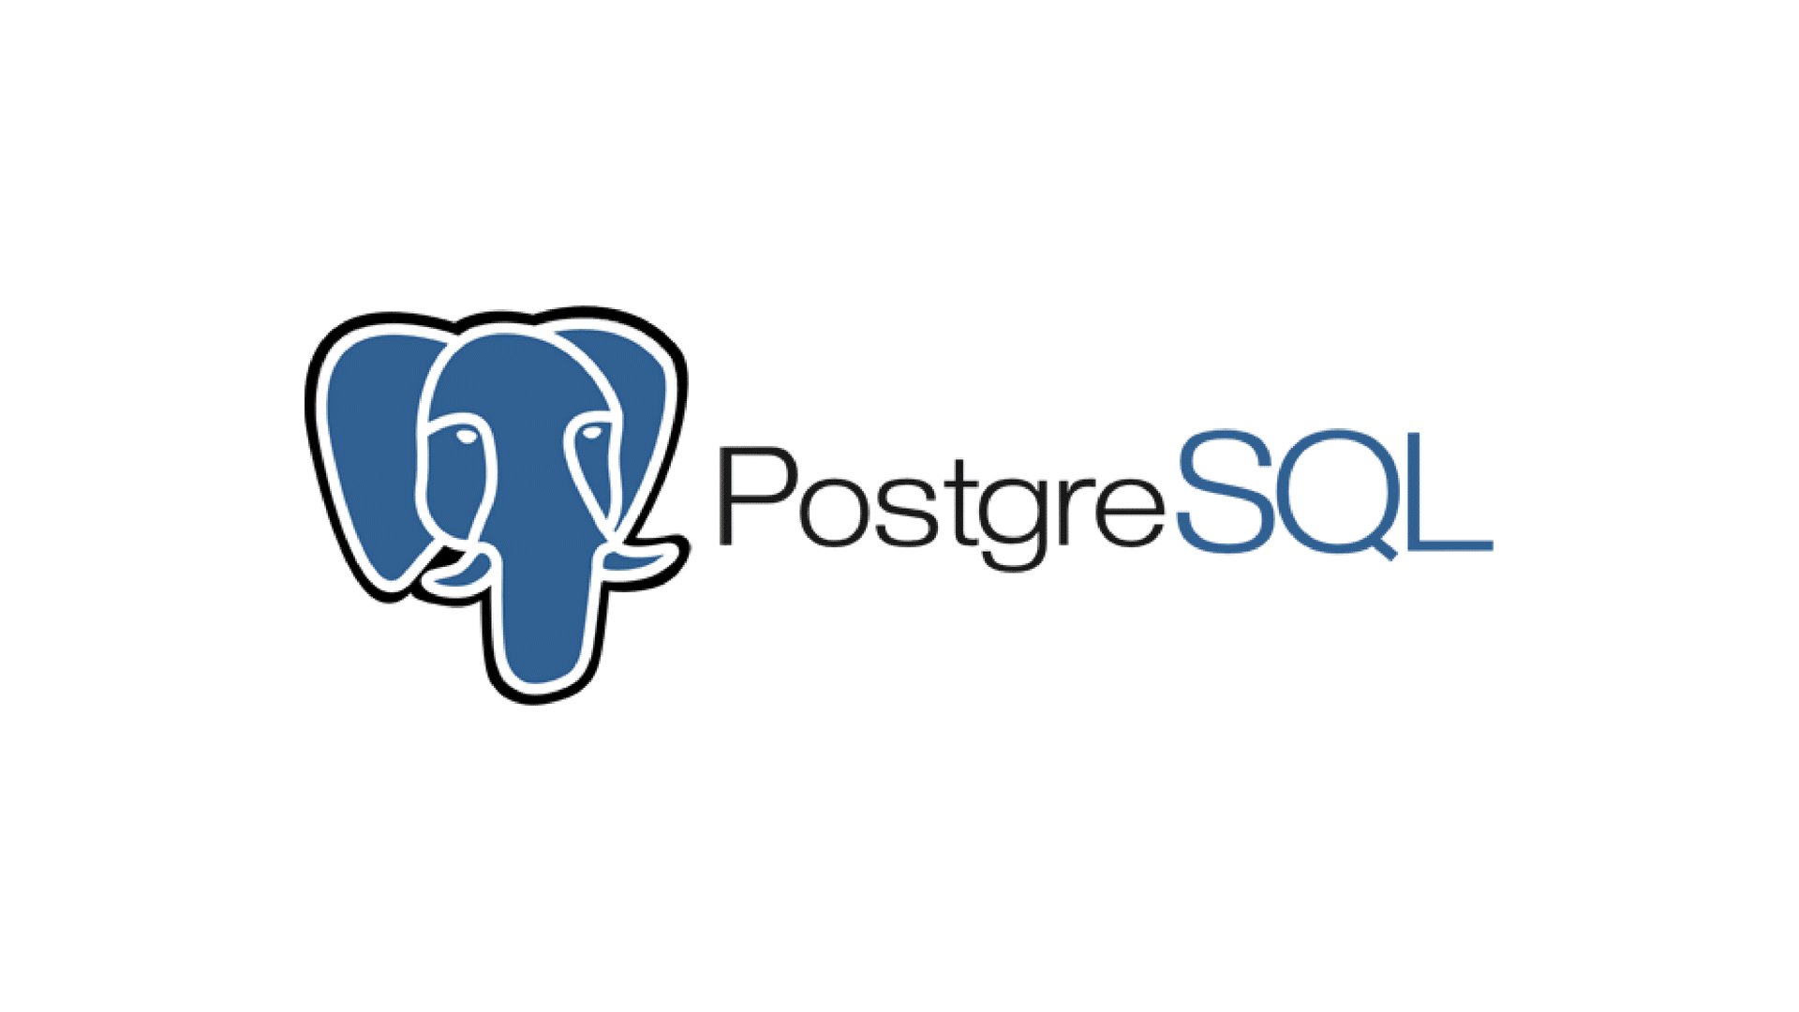
Writing Kafka Database to PostgreSQL
Producer
Consumer
DB
DB

Slide 2
How to write?
Import pandas, kafka-python and psycopg2
Create Producer Object
Create a topic
Read data
Encode messages and sent messages
Create to Consumer Object
Connect DB
Create Table
Decode mesages and write mesages

Slide 3
Features of the psycopg2 library
It is a library in the Python programming language used for connection and data manipulation to the PostgreSQL database.
Converts data in database to objects
Easily read and modify the data stored in the Python database through Python codes.
Add new data to the database, update the data and query the data

